Slide 1

Basic Immunology by
IBITOYE OLUKAYODE A.
DEPARTMENT OF MICROBIOLOGY AND IMMUNOLOGY
KAMPALA INTERNATIONAL UNIVERSITY, UGANDA

Slide 2
Learning Objectives for Immunology Overview
Upon completion of this lecture and exercises the student will be able to:
  Define the terms immunity, immunology
  Describe major historical events in the development of immunology
  Differentiate innate and adaptive immunity in terms of components and type of immune response.
  Explain the major defenses of innate immunity
  Describe the mechanisms used by the body to defend itself in an innate response.

Slide 3
Outline
1.1. Terminologies in immunology
1.2. History of immunology
1.3. The immune system
1.4. Natural immune system
1.5. Adaptive immune system

Slide 4
Chapter 1
An Overview of the Immune System

Slide 5
Definition of the terms
Immunology can be defined as the study of immune system or immunity.
It can also be stated as the study of all aspects of host defense against infection and of adverse consequences of immune responses.
It is also the study of the physiological mechanisms which enable the body to recognize materials as foreign and to neutralize, metabolize or eliminate them without injury to the host tissue.

Slide 6
cont…
Immunity can be defined as the state of being protected from infectious diseases
  Immune system
This is a remarkably versatile defense system that has evolved to protect humans from invading pathogenic microorganisms and cancer.
It is able to generate an enormous variety of cells and molecules capable of specifically recognizing and eliminating an apparently limitless variety of foreign invaders.

Slide 7
1.2. History of immunology
Its principles among the earliest written observations;
Individuals recovering from certain disease rarely contracted that same disease again.
observation promoted deliberate attempts to induce immunity
Athens plague as of Thucydides in 430BC (recovered people only nurse sick one)

Slide 8
cont…
In the year 1500A.D the Chinese developed a custom of inhaling crusts from smallpox lesions to prevent development of small pox in later life. This is a principle called vaccination
Injecting materials from crusts or fluid from smallpox blisters (“variolation”), used through out the eastern world, in 1718 was introduced into western medicine by British ambassador’s wife, to Turkey, had her children so treated.
    Note- The virus used could be transmitted => protection by variolation was hazardous to the community at large!!

Slide 9
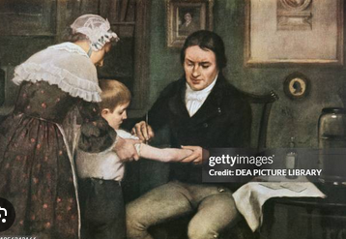
Continued
In 1798, Jenner’s work on vaccination, describing a related, yet safe procedure.
  Noted people, who had cow pox, were spared in small pox epidemics,
  inoculated boy with pus from milk maid with cow pox, and
  re-inoculated same boy with infectious pus from a patient in the active small pox.
  No disease state followed these inoculations, and experiment was repeated several times with great success!

Slide 10
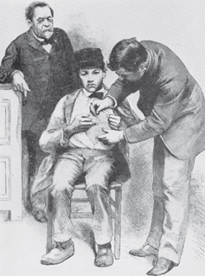
cont…
Louis Pasteur- demonstrating
that it was possible to attenuate, or weaken, a pathogen and administer the attenuated strain as a vaccine.
In 1885, Pasteur administered his first vaccine to a human, a young boy who had been bitten repeatedly by a rabid dog
Wood engraving of Louis Pasteur watching Joseph Meister receive the rabies vaccine. [From Harper’s Weekly 29:836; courtesy of the National Library of Medicine.]

Slide 11
cont…
Jenner`s provided first clear evidence that active immunization could be used safely to prevent an infectious disease.
Almost 70 Years later, Pasteur - introduced pasteurization also
  Recognized and exploited the general principle underlying vaccination
At about 1900,
  Role of phagocytes and cellular immunity were elucidated

Slide 12
cont…
  Killed vaccines were introduced
  Complement was described
In 20th century,
  Acquired immunity resulted from both cellular and humoral elements were demonstrated.
  Opsonization was described
  The term antigen came in to regular use

Slide 13
An Overview of the Immune System
Immune System
Innate
(Nonspecific)
Adaptive
(Specific)
Cellular
Components
Humoral
Components
Cell-Mediated
Humoral
(Ab)

Slide 14
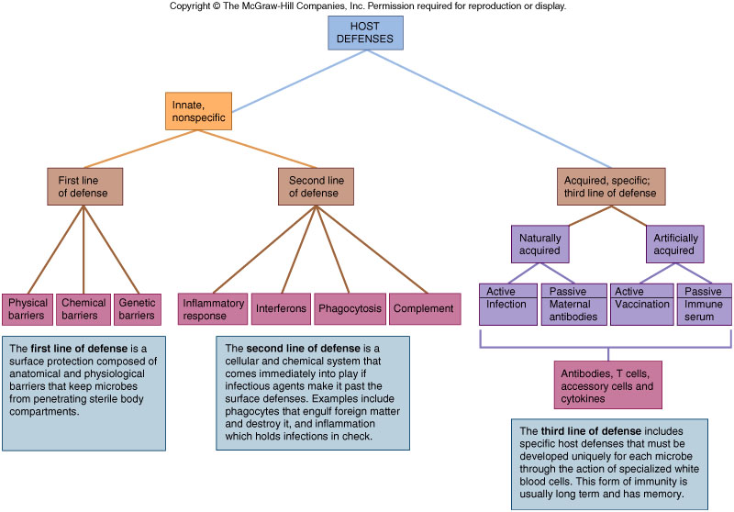
Overview of the Immune System
1.3. The immune system

Slide 15
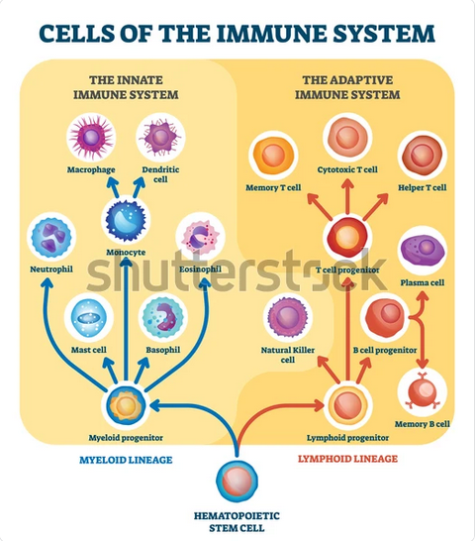

Slide 16
The innate Immune system/response
Characteristic features of the natural immune system (Innate Immunity)
  It’s non – specific
  It’s the first line of defense
  Repeated exposure - no augmentation
Components
  Biochemical
  Physical
  Cells

Slide 17
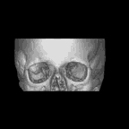

cont…
Components
  Biochemical
    enzymes, C’, etc.
    secretions
    pH
  Physical
    skin
    cilia
  Cells
    Phagocytes, NK
Example
  Burn response
Lysozymes
Mucus
Cilia: trachea
Sebaceous glands
Skin
Acid in
stomach
Commensal
organisms in
gut & vagina
Spermine in semen
Notes:
When a person is burned they lose skin and fluids. This results in multiple complications including high risk for infections.

Slide 18
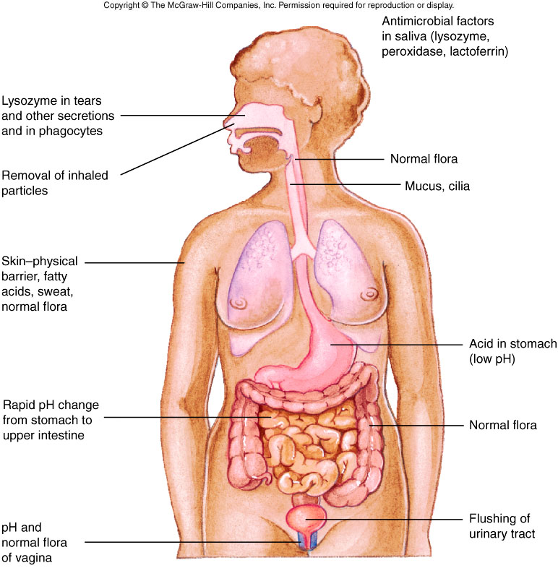
cont…

Slide 19
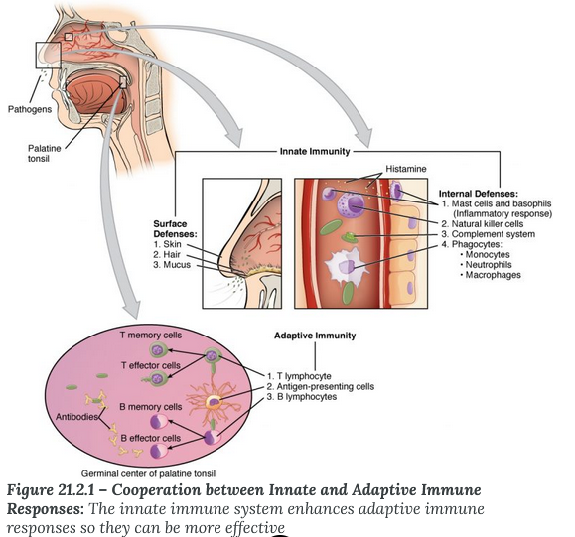

Slide 20
cont…
Overall non-specific reaction of body to injury or invasion – starts immediately with infection or trauma
  Reactants may initiate, expand, or sustain the response
  Can be acute (short duration) or become chronic (prolonged duration)
Has 4 cardinal signs: heat, pain, redness, loss of function resulting from:

Slide 21
cont…
  Increased blood and plasma flow to the area
  Increased capillary permeability by retraction of endothelial cells
  mediated by vasoactive agents such as histamine and prostaglandins.
    derived from injured cells and later from cells that infiltrate the area.
  Migration of leucocytes, particularly Neutrophils and macrophages, from the capillaries to the site of injury is due to a process called chemotaxis.

Slide 22
cont…
    Migration of white cells, especially early migration of neutrophils then macrophages to the area
    Increased release of mediators such as histamine from damaged mast cells – furthering capillary dilation
    Increased concentration of acute phase reactants that can amplify and/or control the response
  Complement – a series of enzymes normally circulating in an inactive form may be activated resulting in lysis or enhanced phagocytosis of cells

Slide 23
cont…
1.4.1 External Innate Defense Systems
Prevent entrance:
  Structural barriers – effective against most microorganisms
    Skin - epidermis = layers of tightly packed epithelial cells. Outer layer is dead cells and keratin, waterproofing protein
    Inner layer skin - dermis = blood vessels, hair follicles, sweat glands, and sebaceous glands that produce an oily secretion called sebum
    Cilia and cough reflex – helps expel microbe containing mucous
    Sneeze

Slide 24
cont…
1.4.1 External Innate Defense Systems
Mucus - conjunctivae, alimentary, respiratory, and urogenital tracts
    saliva, tears, and mucous secretions wash away invaders and contain antibacterial or antiviral substances.
    acidity (pH 5.6) of sweat, sebaceous glands, vagina (pH 5) and stomach (pH 1) – unfriendly to many microorganisms
    enzymes present in the skin and stomach, tears
Normal flora - out compete pathogens for attachment sites on the epithelial cell surface and for necessary nutrients.

Slide 25
cont…
1.4.2 Internal Innate Defense System
To prevent expansion of penetration
  Recognize carbohydrates not normally present on cells such as mannose
  May cause nonspecific activation of white cells
    Phagocytosis – by neutrophils, eosinophils, basophils, or macrophages, mast cells, and dendritic cells
  Clotting mechanism which entraps organisms in fibrin clots
  Complement System can lyse cells or enhance phagocytosis

Slide 26
cont…
Physiologic Barriers
Soluble factors contribute to innate immunity, they are collectively known as acute phase reactants.
Normal serum components, non-specific responders to inflammation
Increase because of infection, injury, trauma
Produced mostly by liver in response to inflammation and cytokine stimulation
  Cytokines: IL-1, IL-6 and TNF alpha which are produced by macrophages and monocytes at inflammatory site are activators

Slide 27
cont…
Acute phase reactants are chemically varied and include:
  C-reactive protein,
  serum amyloid A,
  mannose binding protein,
  alpha-1 anti-trypsin,
  haptoglobulin,
  fibrinogen,
  ceruloplasmin,
  alpha-1 acid glycoprotein
  Complement

Slide 28
cont…
Complement – a series of enzymes normally circulating in an inactive form
  May be activated by the classical, Mannose Binding Lectin, or alternate pathways
  Can result in lysis or enhanced phagocytosis of cells
Lysozyme, a hydrolytic enzyme in mucous secretions and in tears, can cleave the peptidoglycan layer of bacterial cell wall.
Interferon, proteins produced by virus-infected cells. Has many functions including ability to bind to nearby cells and induce a generalized antiviral state.

Slide 29
cont…
C-Reactive Protein
Normally trace levels in serum
Early acute inflammation indicator:
  increases within 4-6 hrs of infection or trauma
  100 to 1000 fold increase serum concentration
  concentration drops rapidly in serum when stimulus removed
Enhances opsonization, agglutination, precipitation, and classical pathway complement activation – enhances removal of irritant

Slide 30
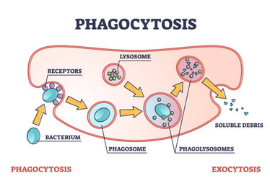
cont…
Phagocytosis
Phagocytic cells Chemotaxins such as
  Complement components
  Coagulation cascade proteins
  Bacterial and viral products
Attract phagocytic cells including:
  Mast cell, lymphocyte, macrophage, neutrophil products
Physical contact between phagocytic cell and foreign object results in
  Formation of phagosome
  Formation of phagolysosome
  Digestion
  Release of debris

Slide 31
cont…
Phagocytosis
  Is a form of endocytosis.
  Important body defense mechanism is process in which specialized cells engulf and destroy foreign particles such as microorganisms or damaged cells.
  Macrophages and segmented Neutrophils are the most important phagocytic cells.

Slide 32
cont…
Can be divided in to several stages:
  chemotaxis – attraction of leukocytes or other cells by chemicals
  Movement of neutrophils is influenced by chemotaxins – chemical messengers
    Complement, proteins from coagulation,
    Products from bacteria and viruses,
    Secretions from mast cells, lymphocytes, macrophages, and other neutrophils

Slide 33
cont…
Phagocytosis ...
  Adherence – binding of organism to the surface of phagocytic cell.
  Engulfment:- is the ingestion of microorganisms and formation of phagosomes.
  Digestion – after the foreign particle or microorganisms is ingested, cytoplasm, lysosome fuse with phagosome The enzymes of lysosome then contribute to microbial lysis.

Slide 34
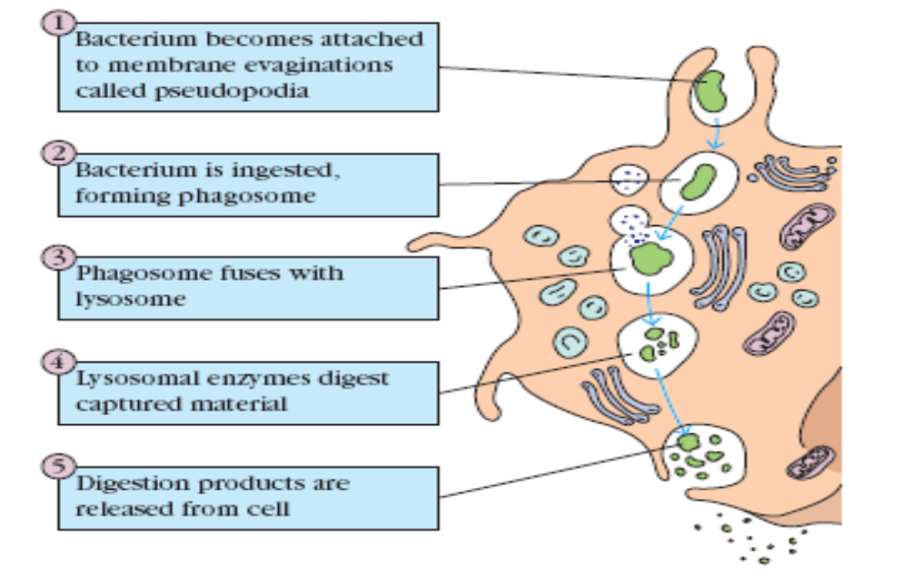
cont…
Phagocytosis ...
Source: Kuby immunology 2007, 5th ed

Slide 35
1.5. The adaptive immune system
Immune System
Innate
(Nonspecific)
Adaptive
(Specific)
Cellular
Components
Humoral
Components
Cell-Mediated
Humoral
(Ab)

Slide 36
1.5. The adaptive immune system

Slide 37
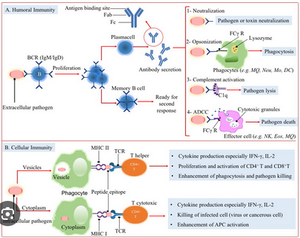
AN OVERVIEW OF ADAPTIVE IMMUNITY

Slide 38
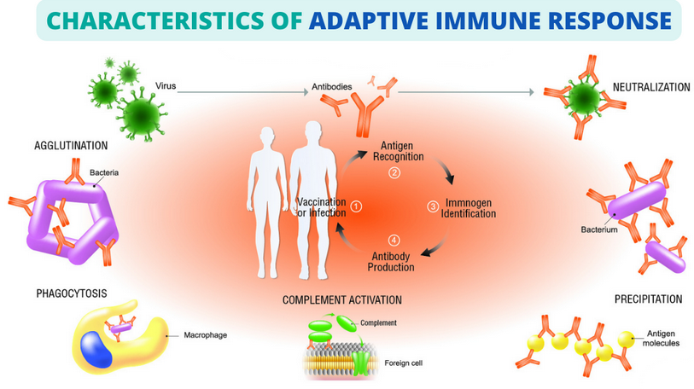

Slide 39
1.5. The adaptive immune system
1.5. Adaptive Immunity
    Specific
    Third line of defense
    Repeated exposure - augmented – memory
    Slower response
    More vigorous response
    Longer lasting response
    Anamnestic
Components
  Classic Immune System
      Cells (Cell mediated) =CMI
      Soluble Factors (Humoral immunity) = HI

Slide 40
1.5. The adaptive immune system
Capable of recognizing and selectively eliminating specific foreign microorganisms and molecules(i.e., foreign antigens).
Unlike innate immune responses, adaptive immune responses are reactions to specific antigenic challenges
Different populations of lymphocytes and their products are the major actors together with accessory cells – Antigen presenting cells (APCs)
Cardinal features are :
  Specificity
  Diversity , Memory,

Slide 41
1.5. The adaptive immune system
Cardinal Features of adaptive Immune Responses
Specificity –
  specific for distinct antigen, and
  for different structural components of a single complex protein, polysaccharide, or other macromolecules.
  Portions of such antigens recognized by individual lymphocytes are called determinants or epitopes.
  This fine specificity exists because individual lymphocyte express membrane receptors able to distinguish subtle (slight) differences in structure between distinct antigens.

Slide 42
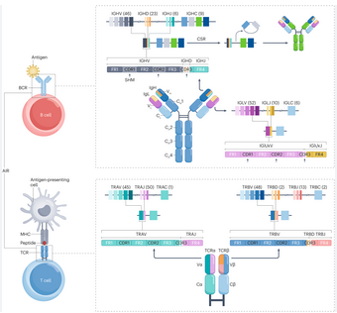
1.5. The adaptive immune system
Diversity- total number of antigenic specificities of the lymphocytes in an individual, called the lymphocyte repertoire, is extremely large.
  estimated mammalian immune system can discriminate 10⁹ to 10¹¹ distinct antigenic date in human immune system
  This property of the lymphocyte repertoire is called diversity. It is the result of variability in the structures of antigen-binding sites of lymphocyte receptors for antigens.

Slide 43
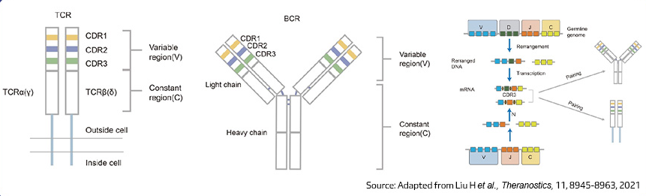

Slide 44
1.5. The adaptive immune system
Memory- Exposure of the immune system to foreign antigen:
  enhances its ability to respond again to that antigen.
  Responses to second and subsequent exposure to the same antigen, called secondary immune responses, are usually more rapid and larger than the first or primary immune response.

Slide 45
1.5. The adaptive immune system
An effective immune response involves three major groups of cells: Cellular Immunity (T lymphocytes), Humoral Immunity (B cells), and Accessory cells (antigen-presenting cells).
The two major populations of lymphocytes—B lymphocytes (B cells) of Humoral immunity and T lymphocytes (T cells) of Cellular Immunity provide us with our specific adaptive immunity

Slide 46
1.5. The adaptive immune system
Specialization –the immune system responds in distinct and special ways to different microbes, maximizing the efficiency of antimicrobial defense mechanisms. Thus, humoral immunity and cell mediated immunity are elicited by different classes of microbes or by the same microbe at different stages of infection (extra cellular & intra cellular)
Self –limitation- All normal immune responses returning the immune system to its resting or basal state with time after antigen stimulations, process called homeostasis.

Slide 47
Comparison of Innate and Adaptive Immunity
Summary of innate and adaptive immunity
Innate Immunity
Adaptive Immunity
No time lag
A lag period
Not antigen specific
Antigen specific
No memory
Development
  of memory

Slide 48

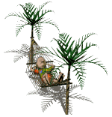






Adaptive and Innate - Interactions
Summary of innate and adaptive immunity
Infectious
Exposure
Innate Immunity
holds
No
Disease
Innate Immunity
Fails
Adaptive Immunity
Specific memory
Disease
Adaptive
Immune system
Second Infectious
Exposure
Same organism
Recovery
Notes:
This picture illustrates innate versus adaptive immunity with specific memory if exposed to the same organism after an initial recovery.

Slide 49
Review questions
  Define the term immunity and immunology?
  Describe the historical events of immunology and its development.
  What is the difference between innate and adaptive immunity in terms of components and type of immune response.
  Explain major defense mechanism of innate immunity and adaptive immune system

Slide 50
Reference
Kuby; Goldsby et. al. Immunology. 2007 (5th ed)
Tizard. Immunology an introduction,4th edition ,Saunders publishing,1994
Naville J. Bryant Laboratory Immunology and Serology 3rd edition. Serological services Ltd.Toronto,Ontario,Canada,1992
Abul K. Abbas and Andrew H. Lichtman. Cellular And Molecular Immunology 2008, 5th edition
Mary T. Keogan, Eleanor M. Wallace and Paula O’Leary Concise clinical immunology for health professionals , 2006
Ivan M. Roitt and Peter J. Delves Essential immunology 2001, 3rd ed
Reginald Gorczynski and Jacqueline Stanley, Clinical immunology 1990.

Slide 51


